Slide 1
TOP SECRET
PLASTIC ARMY SARGE CLEARANCE ONLY

Slide 2
“I am LT. Bridgette- I am the special operations officer for sector 513”
Commander- quickly
assemble your men.
You have a mission.

Slide 3
SITUATION
(SMEAC Brief)
Commander- we have a serious situation. A Green Army fighter with a crew of 3 troops was last seen flying in the vicinity of MAP area 513.
The fighter was engaged and shot down by enemy troops.
The crew bailed out and landed in the area of grid D15

Slide 4
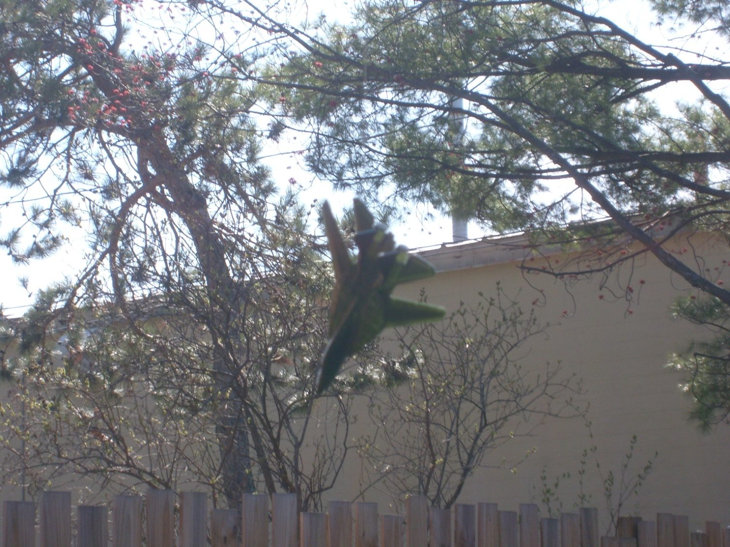

Slide 5
MISSION TASKS
1. Locate LRRP team “Shelly69” and evacuate the wounded crew
2. Move to crash site and secure sniper team “Misfit”
3. Secure crash site and evacuate area with LRRP team “Shelly69” and sniper team “Misfit”

Slide 6
Execution DETAILS
Insert and move to grid D15
Secure Drop Zone (DZ)-
From DZ move E 7 klicks then N 14 klicks
Locate “Shelly69” and evac wounded
Move back to DZ
From DZ establish North on the compass and move 240 degrees for 17 klicks to the crash site
Secure crash site and call in helo extract

Slide 7
ADMIN and LOGISTICS
Utilize your forces, a compass and the sector 513 Map to complete your mission.

Slide 8
COMMAND AND SIGNAL INFORMATION
An ELITE LRRP team- LRRP TEAM “Shelly 69” was inserted to rescue the downed crew.
LRRP team “Shelly69” is transporting wounded crew members to safety.
LRRP team “Shelly69” can no longer transport the wounded.
Sniper team “Misfit” has been inserted to prevent enemy troops from salvaging the crash site

Slide 9
GOOD LUCK COMMANDER

