Slide 1
PLASTIC OPS MISSON
Only for plastic ops commander to see.

Slide 2
Getting ready
1 gather your troops quickly
2 make them into squads or squad
3 read battle briefing

Slide 3
Here is the story
Some men were driving supplies in a half track to a base 15 klicks away. But they were ambushed and taken to a enemy camp on man from the half track did make it thou and will wait for you to rescue him. The near by base was attacked by enemy and you will be dropped off there so be carful.

Slide 4
Your misson
1 secure the base were you will be dropped in in g 6/7.
2 look for survivors in the base.
3 move to e 9 to find the wreck.(we think!)
4 find the survivor from the wreck.
5 move to g 12 to find a base.
6 look for the captured soldiers

Slide 5
Extra info
If the wreck is not there then call in a chopper and he will take you to a place were he saw smoke.
If there is no base then find a dirt road and set up a trap for the enemy patrol. Then capture a enemy patrol guy then go to were he tells you were the base is.

Slide 6
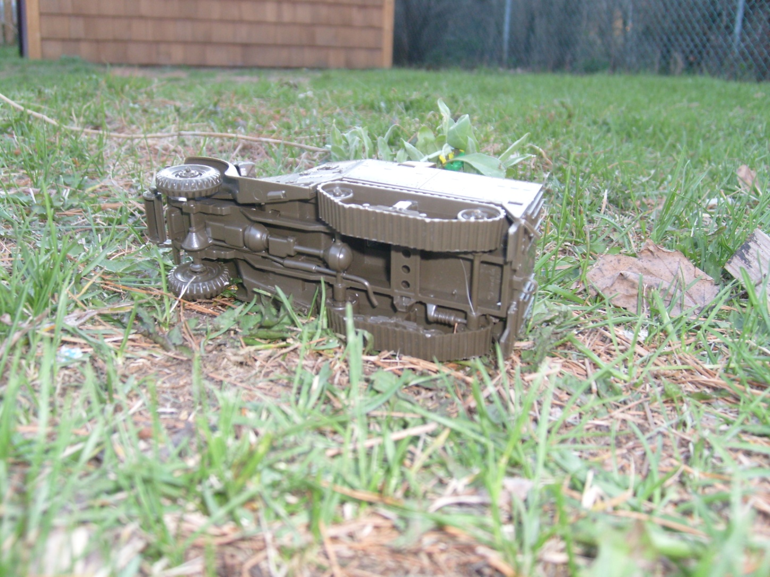
Here is a picture of the wreck
See if you can find the survivor.

Slide 7
When your done
Go to the wreck and call in a chopper
Goo luck soldier

